Slide 1
Wide Area Network (WAN) Essentials

Slide 2
WAN Essentials
A WAN traverses a significant distance and usually supports very high data throughput
Type of WAN needed depends upon the following factors:
Traffic load, budget, geographic breadth, and commercially available technology

Slide 3
WAN Essentials
WAN and LAN differences include the following:
LANs connect nodes; WANs connect networks spread over wide geographic area
Differ at Layers 1 and 2 access methods, topologies, media
Both LANs and WANs use the same protocols from Layer 3 and higher
LANs are typically privately owned
WANs are typically owned and operated by telcos, also known as NSPs (network service providers)
Examples include AT&T, Verizon, Spectrum, and Comcast

Slide 4
Entry Point Equipment (1 of 3)
If you have DSL or cable Internet service, you cannot your home router to a modem
A modem is a demodulation device that converts digital and analog signals
Data Terminal Equipment (DTE) is the customer’s endpoint device on the WAN
Communicates on the LAN and is usually owned by the customer

Slide 5
Entry Point Equipment (1 of 3)
Data Communications Equipment (DCE) is the carrier’s endpoint device for the WAN
Communicates on the WAN and is usually owned by the ISP
Equipment located on the customer’s premises is called CPE (customer premises equipment)
Demarc (demarcation point) is the point where the carrier’s responsibility ends, and the customer’s responsibility begins

Slide 6
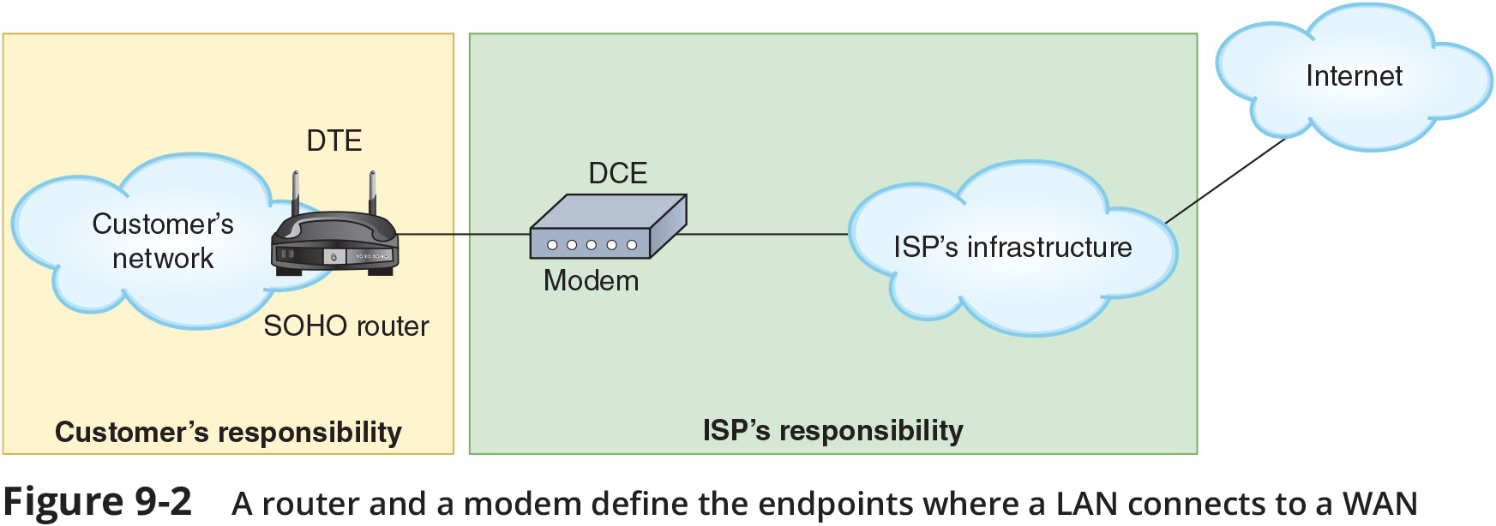
Entry Point Equipment (2 of 3)

Slide 7
Entry Point Equipment (3 of 3)
The following are devices commonly found near the demarc:
NIU (network interface unit) – connects the ISP’s local loop to the customer’s network
Line driver – essentially a repeater that can boost the signal across greater distances
CSU/DSU (channel service unit/data service unit) – serves as the endpoint for a dedicated connection between an ISP and a customer

Slide 8
Routing Protocols (1 of 3)
A router joins two or more networks and passes packets from one network to another
Routers can do the following:
Connect dissimilar networks (LANs and WANs)
Interpret Layer 3 and often Layer 4 addressing
Determine the best path for data to follow from point A to point B
Reroute traffic if the path of first choice is down but another path is available

Slide 9
Routing Protocols (1 of 3)
Routers may perform any of the following optional functions:
Filter broadcast transmissions
Prevent certain types of traffic from getting to a network
Support simultaneous local and remote connectivity
Provide high network fault tolerance through redundant components
Monitor network traffic and report statistics
Diagnose internal or other connectivity problems and trigger alarms

Slide 10
Routing Protocols (2 of 3)
Router categories:
Core routers, also called interior routers, direct data between networks within the same autonomous system (AS)
Edge routers, or border routers, connect an autonomous system with an outside network
Exterior routers refers to any router outside the organisation’s AS
Direct data between autonomous systems

Slide 11
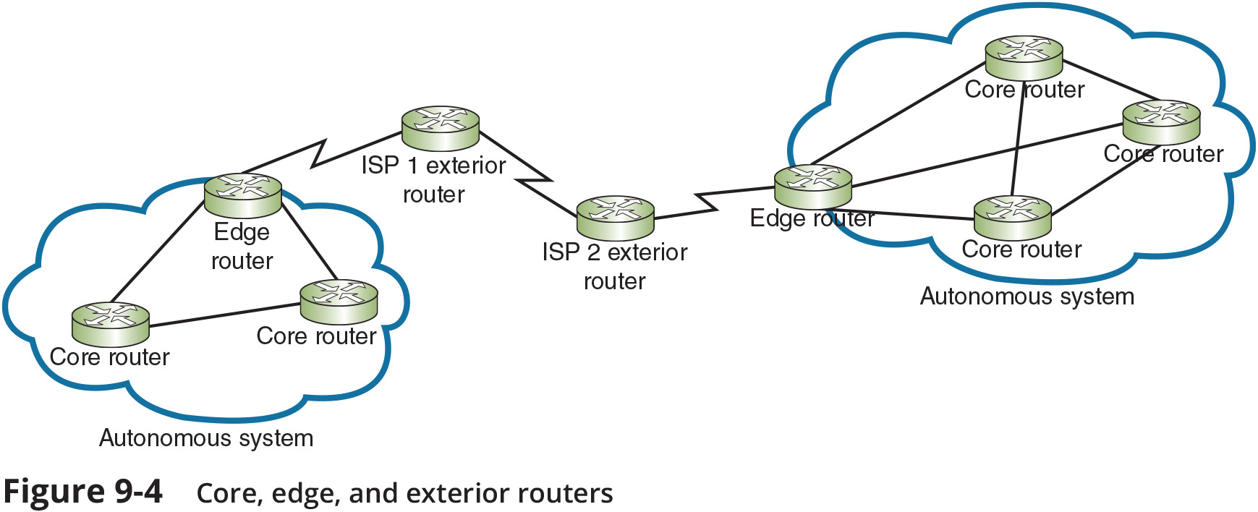
Routing Protocols (3 of 3)

Slide 12
Routing Tables (1 of 2)
A routing table is a database that holds information about where hosts are located and the most efficient way to reach them
Routers rely on them to identify which router is the next hop to reach a particular destination host
Routing tables contain IP addresses and network masks that identify a network that a host or another router belongs to

Slide 13
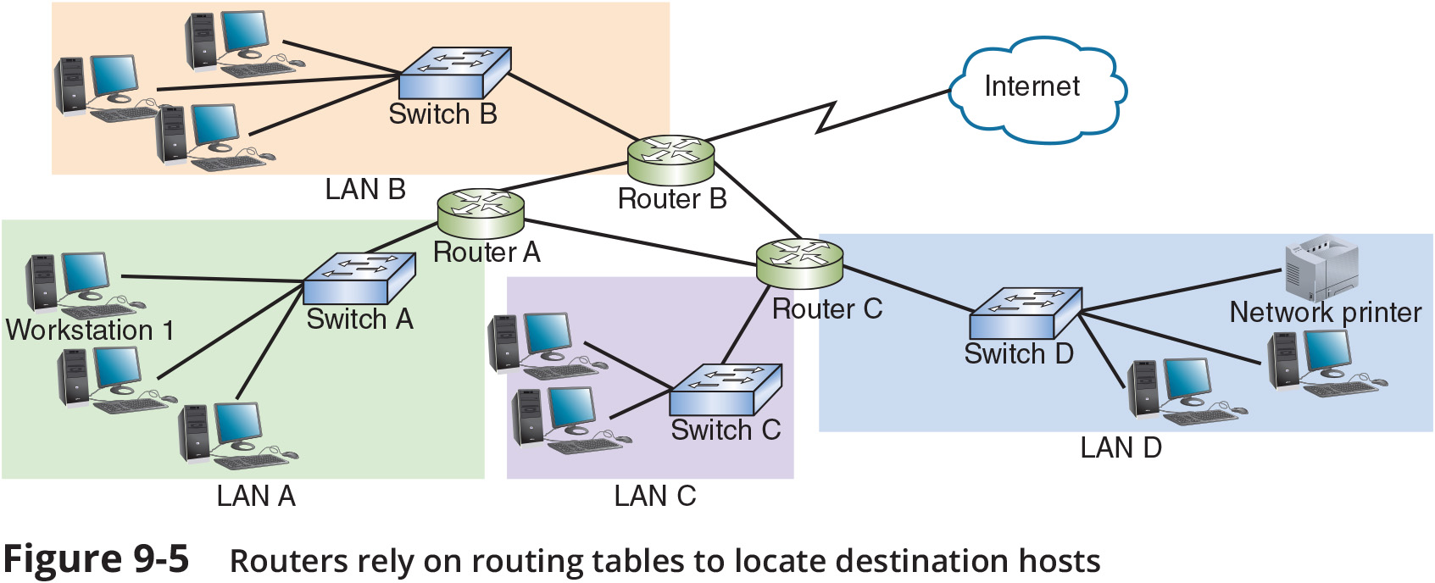
Routing Tables (2 of 2)

Slide 14
Routing Path Types
Routing paths are determined in one of two ways
Static routing – A network administrators configures a routing table to direct messages along specific paths
Example - a static route between a small business and its ISP
Dynamic routing – A router automatically calculates the best path between two networks and maintains this information in a routing table
The router can detect problems with failed or congested routes and reroute messages through a different path

Slide 15
route
The route utility allows you to view a host’s routing table
The route command can also be used to add or delete static routes
The following are some variations of the route command for different operating systems:
On a Linux or UNIX system, use the command route
On a Windows-based system, use the command route print
On a Cisco IOS, use the command show ip route

Slide 16
Routing Metrics
Routing metrics are properties of a route used by routers to determine the best path to a destination:
Hop count
Theoretical bandwidth and actual throughput
Delay, or latency, on a potential path
Load, or the traffic or processing burden
MTU (maximum transmission unit), or the largest IP packet size in bytes allowable without fragmentation
Routing cost, or a value assigned to a particular route
Reliability of a potential path
Topology of a network

Slide 17
Routing Protocols to Determine Best Paths
Routing protocols are used by routers to communicate with each other to determine the best path
Routers rate the reliability and priority of a routing protocol’s data based on these criteria:
AD (administrative distance) – a number indicating the protocol’s reliability
Convergence time – the time it takes to recognise a best path in the event of a change or network outage
Overhead – the burden placed on the underlying network to support the protocol

Slide 18
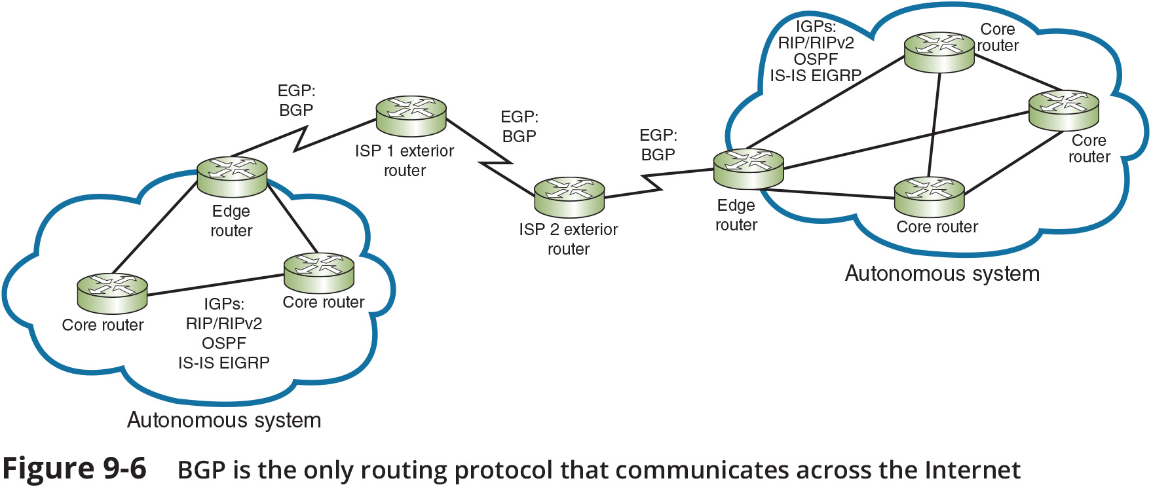
Interior and Exterior Gateway Protocols (1 of 5)
IGPs (interior gateway protocols) are routing protocols used by core routers and edge routers within autonomous systems and are often grouped according to the algorithms they use to calculate best paths:
Distance-vector routing protocols calculate path on the basis of the distance to that destination
Link-state routing protocols enables routers to communicate beyond neighboring routers in order to independently map the network and determine the best path

Slide 19
Interior and Exterior Gateway Protocols (1 of 5)
EGPs (exterior gateway protocols) are used by edge routers and exterior routers to distribute data outside of autonomous systems
The only EGP currently in use is BGP

Slide 20
Interior and Exterior Gateway Protocols (3 of 5)
OSPF (Open Shortest Path First) is an IGP, and a link-state protocol used on interior or border routers
Characteristics include the following:
Supports large networks - imposes no hop limits (unlike RIP)
Complex algorithm – calculates a more efficient best path
Shared data – maintains a database of other routers’ links
Low overhead, fast convergence – demands more memory and CPU power for calculations, but keeps network bandwidth to a minimum and provides a very fast convergence time
Stability – uses algorithms that prevent routing loops
Multi-vendor routers – supported by all modern routers

Slide 21
Interior and Exterior Gateway Protocols (4 of 5)
IS-IS (Intermediate System to Intermediate System) is an IGP and link-state routing protocol
It uses a best-path algorithm similar to OSPF’s
It is designed for use on core routers only (unlike OSPF)

Slide 22
Interior and Exterior Gateway Protocols (4 of 5)
EIGRP (Enhanced Interior Gateway Routing Protocol) is an advanced distance-vector protocol that combines some of the features of a link-state protocol
It is often referred to as a hybrid protocol
Offers fast convergence time and low network overhead
It is easier to configure and less CPU-intensive than OSPF
Supports multiple protocols and limits unnecessary network traffic between routers
EIGRP was originally proprietary to Cisco routers

Slide 23
Interior and Exterior Gateway Protocols (5 of 5)
BGP (Border Gateway Protocol) is the only current EGP and is known as the “protocol of the Internet”
BGP spans multiple autonomous systems
Special characteristics of BGP include the following:
Path-vector routing protocol
Efficient
Customisable
BGP is the most complex of the routing protocols mentioned in this module

Slide 24
Routing Redundancy
Large networks should have multiple ISP connections with each using geographically separate hardware and network media
Two redundancy techniques include the following:
Active-active redundancy – all redundant resources are active at all times, and work is distributed among them
Active-passive redundancy – only one or a few redundant resources are active at any time with the backup devices on standby

Slide 25
Routing Redundancy
FHRP (First Hop Redundancy Protocol) can be used to provide a VIP (virtual IP) address as the default gateway
VRRP (Virtual Router Redundancy Protocol)
HSRP (Hot Standby Routing Protocol)
GLBP (Gateway Load Balancing Protocol)

